Slide 1
Applying to the SOE
Education Coursework - Blocks
Field Experiences
AGENDA
TaskStream
Certification
School of Education Support
Getting Plugged In

Slide 2
Adolescence Education
Adolescence - period of time and transition from childhood to adulthood
Adolescents - these are the students in your class
Childhood Education
Childhood - period of time
Children - the students in the classroom

Slide 3
Applying to the SOE
School of Education --> Admissions
Accepted on a rolling basis
2.75 for admission into the SOE
Ideally apply Freshman or Sophomore year
2.5 each semester and cumulative for block progression**
Major: Bachelor of Arts/Science in your content area of study:
English
Math
History
Spanish or French
Biology, Physics, Chemistry, Geological Science
Addition of the Adolescence Education certification

Slide 4
Coursework for Degree Completion
General Education Coursework
Major Coursework
Education Coursework
Consult Degree Works and your academic advisor
Consult Degree Works and your academic advisor
Consult Degree Works and Melissa Dussault or Jennifer Haines for guidance
1
2
3

Slide 5
Education Coursework
[---Sophomore Year---] [------------------Junior Year--------------------] [-----Senior Year-------]
Block I
Block II
Block III
Block IV
INTD 203
EDUC 204 & SPED 205
** only offered in the Fall
INTD 301 & 302**
** only offered in the Spring
Student Teaching
EDUC 240 - Middle School placement
EDUC 250 - High School placement
EDUC 303 - online and seminar format
EDUC 215 (preferably during Block II)
PSYC 216 (INTD 203 prereq)
H&PE 350 (INTD 203 prereq)

Slide 6
Block Sequence
Once you begin the block sequence, it is not recommended that the sequence be broken.
Backward Planning
Deferment of Student Teaching

Slide 7
SAMPLE TIMELINE
Sophomore Year
Fall Semester
INTD 203
Spring Semester
PSYC 216
H&PE 350
Can be done Jr. Year
Note: only referring to Education requirements – does not show GenEd or Major requirements
Junior Year
Fall Semester
EDUC 215
BLOCK II:
EDUC 204
SPED 205
Spring Semester
BLOCK III:
INTD 301
INTD 302
Senior Year
Fall Semester
Student Teaching?
Spring Semester
Student Teaching?

Slide 8
Embedded Field Experiences
Block I
Block II
Block III
Block IV
INTD 203
Credit of 5
hours
EDUC 204 & SPED 205
** only offered in the Fall
12.5 hours of school visits
20 hours for practicum to be done during the semester or during winter break
INTD 301 & 302**
** only offered in the Spring
Total of 37.5 hours for practicum in a single placement (12.5 can be tutoring hours in an alternate setting)
Student Teaching
EDUC 240 - Middle School placement
EDUC 250 - High School placement
EDUC 215
(25 hours - tutoring)

Slide 9
Field Experiences
Experiences are progressive in nature:
Observation → Active Participation → Individual practicum → Student Teaching
Block III - transportation is essential due to individual placements
Make the most of your experiences - DO NOT default to sitting back and observing
Use the SOE Master Schedule to plan for field experience times. Can be found in the QuickLinks on the SOE homepage.
Be sure to register for the Field Experience Component as well as the course, if applicable.

Slide 10
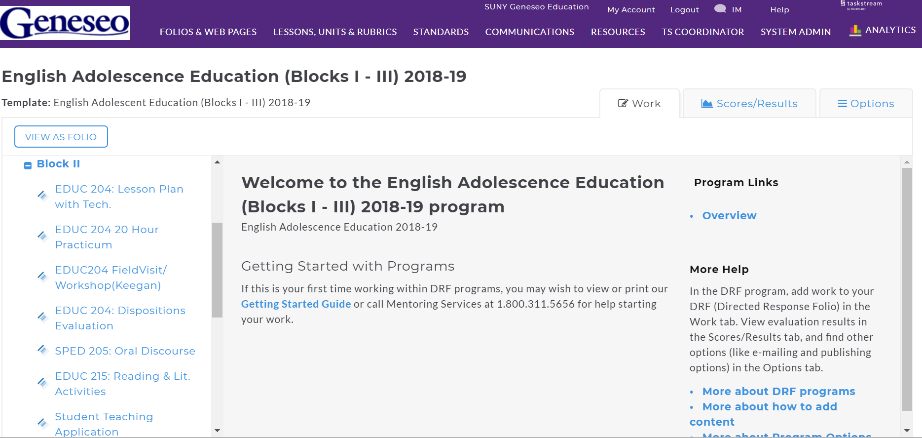
TaskStream
Your account will have:
DRF for Block I - III
DRF for Student Teaching
TPA submission to Pearson
You will learn more about the use of TaskStream during INTD 203, including how to sign up for an account and the costs associated.
1
2
3
4

Slide 11
TaskStream
1
Each Block is listed with the key assignment submission links.
2
3
4

Slide 12
TaskStream
1
2
Blocks II and III have Dispositions Evaluations (Professional Behaviors) that will be completed by your course instructor and cooperating teacher (as part of the practicum evaluation.)
3
4

Slide 13
TaskStream
1
2
3
During Block II, you will attend a Student Teaching Application meeting that will provide information regarding the requirements for student teaching, the application process and deadlines, and student teaching information.
4

Slide 14
Student Teaching Info Sessions
Student Teaching Application Meeting
Pre-Student Teaching Meeting
One year prior to to the semester you are slated to student teach (you’d most likely be in Block II at this time)
Provides the following information:
Requirements
Application Procedures
Student Teaching Placements
Semester prior to student teaching (you’d most likely be in Block III or it would be the following fall semester if you choose to defer student teaching to the spring)
Provides the following information:
Timeline of the process
Expectations
Assignments
Dispositions

Slide 15
Planning Ahead: Student Teaching
Be mindful of the student teaching requirements:
GPA: 2.5 overall, major, and education coursework**
Completion of at least two-thirds of total credit hours required in your major
World Language Majors (OPI and WPI exams)
Education Blocks and Required Courses:
H&PE 350 (SAVE, Child Abuse, and DASA seminar) & BBP
PSCY 216
Foreign Language (General Education Requirement)
Fingerprinting

Slide 16
New York State Teacher Certification Requirements
NYSED - Office of Teaching Initiatives
TEACH Account
DASA Workshop
Fingerprint Clearance
Completion of Educator Preparation Program and Institutional Recommendation
Certification Exams

Slide 17
Certification Exams
Content Specialty Test (CST)
Adolescence Education candidates select the exam for their content area (i.e. Biology). This is taken after major coursework is completed.
Educating All Students (EAS)
This exam is taken after education coursework is completed (including student teaching).
edTPA
A performance based assessment that is completed during one of your student teaching placements.

Slide 18
Getting Plugged into the SOE
School of Education --> Organizations for Ed Students
Elementary and Secondary Education Association

Slide 19
School of Education Offices
Located on the second floor in South Hall
Jennifer Haines, Director of Field Experiences
South 212
X5085
haines@geneseo.edu
Melissa Dussault, Director of Student Success
South 219B
X5443
dussaultm@geneseo.edu

Slide 20
Advisement Support
English: Kelly Keegan, South 228B, keegan@geneseo.edu, x5333
World Languages: Willard Heller, Welles 212B, heller@geneseo.edu, x5247
Mathematics: Melissa Sutherland, South 324B, sutherm@geneseo.edu, x5494
Science: Dennis Showers, South 222C, showers@geneseo.edu, x5264
Social Studies: Crystal Simmons, South 228A, simmons@geneseo.edu, x5339

