Slide 1
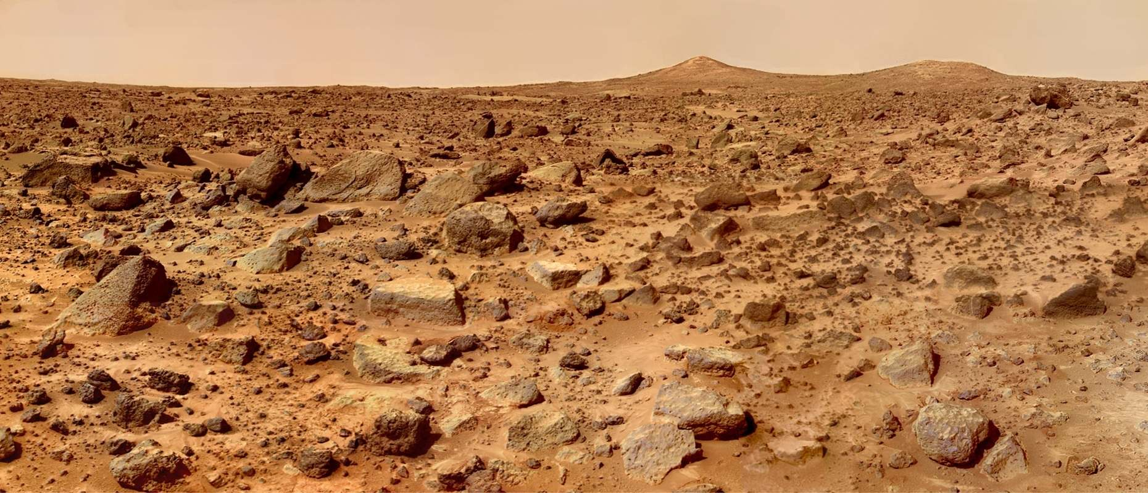
Tube Resonance Question
L
Sound from tube is especially loud for lengths L=1.06m and L=1.48m
250 Hz
What is the speed of sound, and what modes are those?

Slide 2
Tube Resonance Question
L
Sound from tube is especially loud for lengths L=1.06m and L=1.48m
250 Hz
NOTE: Number of loops may be wrong
What is the speed of sound, and what modes are those?
divide
sub in
and solve
solve

