Slide 1
Self Service:
Security
&
View and Update Personal Information

Slide 2
Security: To enhance the ability to identify individuals, you may receive the questions shown in the screen print below the first time logging into self service.

Slide 3
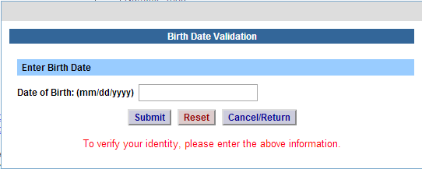
Security continued…
To prevent employees who may be sharing computers from viewing another employees personal information, you will receive the self-service pop-up (below) asking that you verify your date of birth (must be in mm/dd/yyyy format). This will be required each time you request a self-service action of View Paycheck and Human Resource Self Service from our home page.

Slide 4
Self Service Features:
Time and Attendance – available to employees that are active in using TAS. For those employees that are not currently active, a message will appear that this feature is not available.
View Paycheck – available to all employees. Paycheck information will be displayed on the Monday before paychecks are distributed.
Human Resources Self Service – available to all employees. Includes view capabilities for Name, Demographics, and Education. Employees are also able to update their Address, Phone, and Emergency Contacts information.
Self Service

Slide 5
Names: To verify your name, click on the NAME tab (indicated below). To update your name, please click on the Personal form below and return a completed copy to your Human Resources Office. Additional verification is required to complete your name change, further information included on the Personal form.
Personal Form

Slide 6
Demographics: To verify your Demographic information, click on the Demographic tab (indicated below). To update any of your Demographic information, please click on the Personal form (along with the Disability and/or Veteran form, if applicable) below and return a completed copy to your Human Resources Office.
Personal, Disability, and Veteran forms

Slide 7
Address: To verify your address information, click on the Address tab (indicated below). To update your Address, please click on the radio button next to the address you need to change, and select Update.

Slide 8
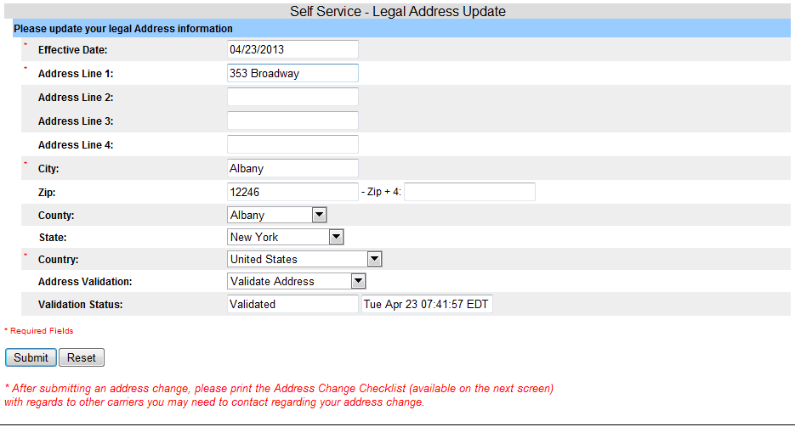
Update Address:
Your current address information will populate in the fields below for updating.
Please enter the effective date of the address change and new address.
When complete, Click Submit. PLEASE TAKE NOTE OF OTHER CARRIERS THAT MAY NEED TO BE CONTACTED REGARDING YOUR ADDRESS CHANGE. A PDF checklist is available on the next screen.
IMPORTANT, PLEASE TAKE NOTE!

Slide 9
Address Validation (QAS):
Upon submit, QAS will validate the address. If the address passes through the QAS process, the validation status will show as verified. With the following messages displayed at the top of the page:
The address change has been submitted successfully for approval. Please contact your Human Resource Department if you have any questions.
&
Please note, your address will also need to be updated with your retirement carrier, any Union sponsored or Long Term Care Insurance and the Registrar's Office for student employees only. It is also important to note that a change in address either from a New York City or Yonkers address to a local address, or from a local address to New York City or Yonkers will impact local taxes. An IT-2104 tax form should be completed at the same time as the address change is requested, indicating residency in New York City or Yonkers. Questions regarding taxes should be directed to your Payroll office.
See screen print below.

Slide 10
Update Address continued: If address change is complete, simply select the Home Page button to go back to the home page, or Logoff. ** Please click and print the Address Change Checklist for your reference.**
Address Checklist - PDF
Home Page or Logoff

Slide 11
QAS Validation:
If the address entered is unable to be validated by QAS, a pop up box will appear with a drop down of valid addresses for the employee to choose from (shown).
If an employee chooses to select an address from the drop down selection and click SELECT ADDRESS, QAS will then validate the address and show the validation status as verified.
If the employee selects KEEP ADDRESS, QAS is unable to validate the address and consequently the validation field will change to Skip Validation, which will allow the employee to accept address as entered.
If an employee enters an address that QAS is not able to validate, the following message will be received:
The address entered could not be validated. Please
confirm that you have given a valid street address
RETURN
Once the employee clicks return, the validation status will appear as declined and the address will be saved as entered.

Slide 12
Phone: To verify your Phone Numbers, click on the PHONE tab (indicated below). To add/ update or delete your phone number(s) simply select the radio button next to the number you wish to take action on and choose the appropriate function (Add, Update, Delete).

Slide 13
Phone – Add The phone details of the Phone Type you chose to take action on will be displayed below to allow you to enter the effective date and new phone number. This information is required. Upon adding a phone number you are also able to link it to another phone type. For example, your home and your cell number is the same. Simply select another type of phone under, “Also consider this my…” Once complete, click on Add Phone.

Slide 14
Phone – Update To update a phone number, select the radio button next to the type of number you need to change and select UPDATE. Your current phone information will populate in the fields below for updating. Enter the effective date and number. Once complete, click “Submit Update to Phone”.

Slide 15
Phone – Delete To delete a phone number, simply select the radio button next to the type of phone number you wish to remove. Click “Delete Phone”.

Slide 16
Emergency Contacts – Add To verify your Emergency Contacts, click on the Emergency Contact tab (indicated below). To add emergency contact information – select ADD then enter the information in the required fields indicated by the asterisk (*) below. At least one phone number is required. Once complete, click on Add Contact. Employees are limited to add up to 3 Emergency Contacts. Once 3 contacts have been added, the ADD button will be grayed out.

Slide 17
Emergency Contact – Update To update an existing Emergency Contact, select the radio button next to the contact you wish to change and click UPDATE. The existing information will automatically populate in the fields below to allow you to make the necessary changes. Once changes are complete, please select Submit Update.

Slide 18
Emergency Contact – Delete To delete an Emergency Contact, select the radio button next to the contact you wish to remove and click DELETE. The existing information will automatically populate in the fields, please select the Delete Contact.

Slide 19
Education: To verify your Education information, click on the Education tab (indicated below). Select the radio button next to the Degree Date and click View Details. To change or correct any of your Education information, please click on the Personal form below and return a completed copy to your Human Resources Office. Verification is required to complete your change, additional information is included on the Personal form.
Personal Form

