Slide 1
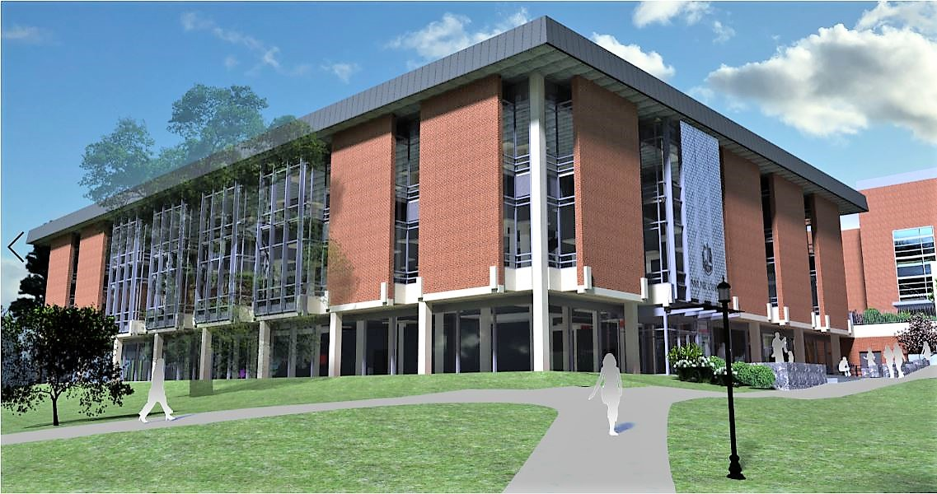
Southwest View

Slide 2
Multi-purpose Room

Slide 3
Main Level Lobby

Slide 4
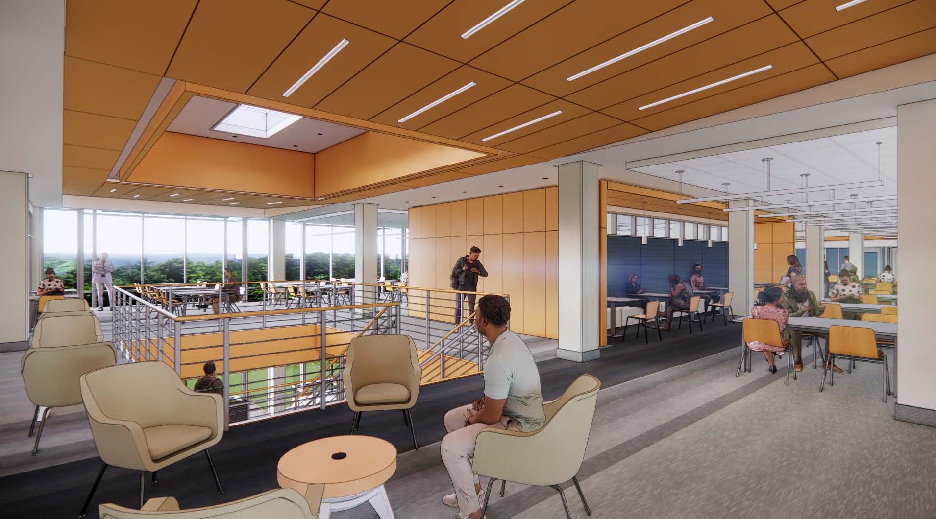
Upper Level Open Stair

Slide 5
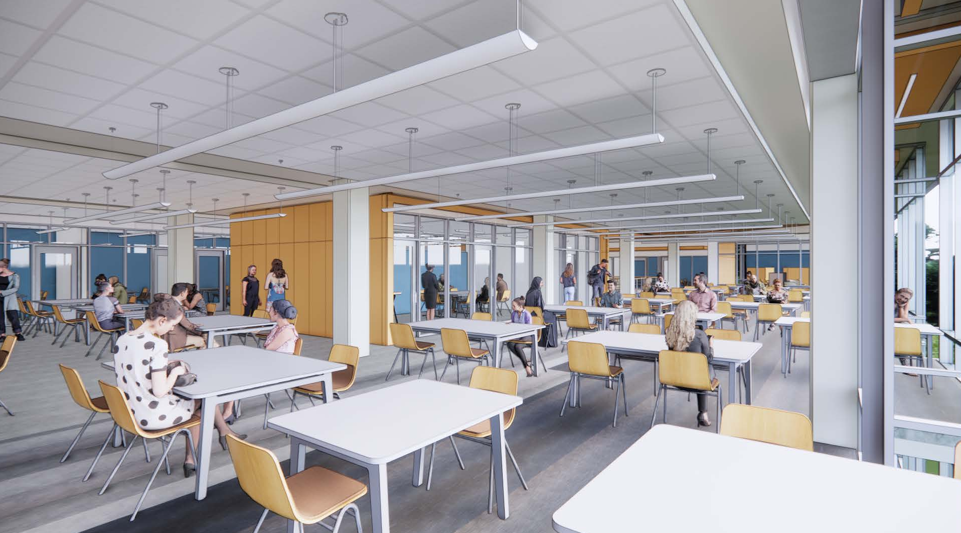
Upper Level Open Seating Area

Slide 6
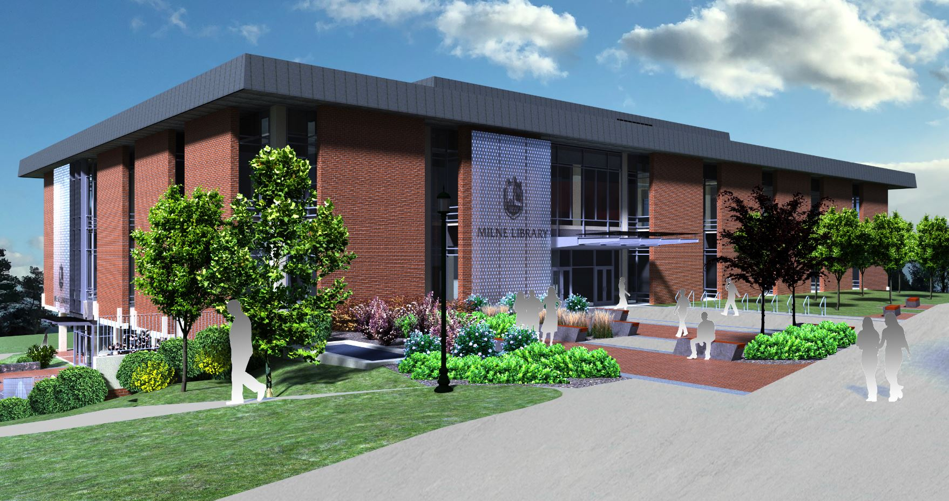
East View

