Slide 1
Lesson 4:
Generators:
Let’s Get Charged!

Slide 2
THE BIG QUESTION
What does a Generator do?

Slide 3
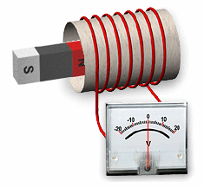
1. The movement of a magnet through coiled wire causes charged particles in the wire to move, resulting in _________.
electricity

Slide 4
Generators
2. An electric generator is a device that converts _________ energy to ________ energy.
kinetic
electrical

Slide 5
Generators
3. A generator consists of __________ and coiled wire.
magnets
4. Kinetic energy moves the magnets (or the coil of wire) and this causes charges in the coiled wire to ________.
flow

Slide 6
Generators
5. A water pump (or even a pump for soap) is similar to a generator because it causes the water to flow but ______________________.
does not create water

Slide 7
PHET Simulation
Click here for a simulation of a generator.

