Slide 1

Electronic
Time & Attendance System
SUNY Geneseo Teaching Faculty
(Live Date: October 1st for September Attendance Report)

Slide 2
Topics:
Sign-in
No sick leave charged
Sick leave charged- leave not pre-requested
Sick leave charged- leave pre-requested
Non-chargeable time
Sign-off
Contact Information

Slide 3
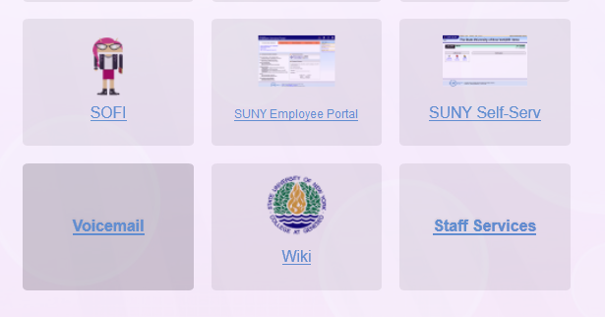
Sign In
Sign in to SUNY electronic Time and Attendance at: https://my.geneseo.edu
Use your existing Geneseo username and password.

Slide 4
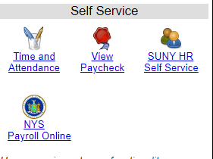
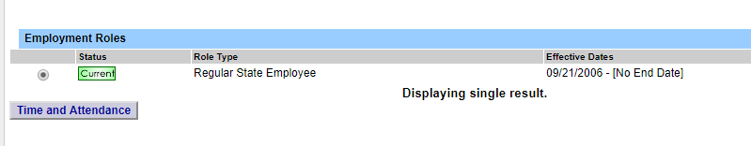
Sign In (Cont.)
Once you have entered your sign-in credentials, click on the “Time & Attendance” icon from the self service section of the portal home screen.
Then, click on “Time and Attendance” from the TAS Home Screen

Slide 5
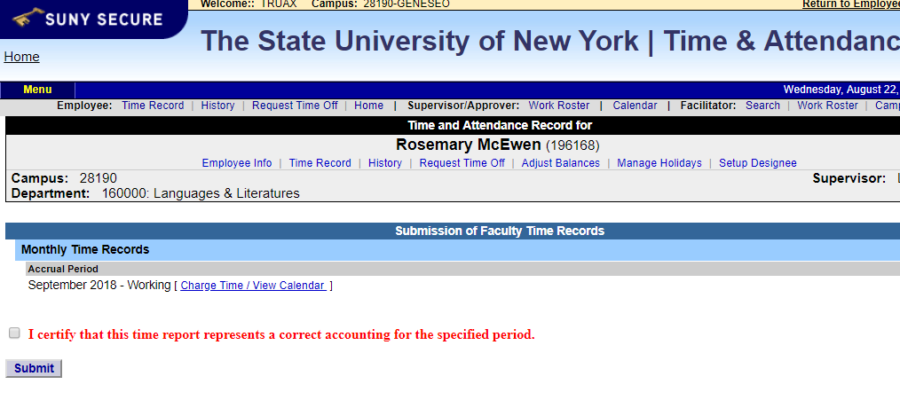
No Sick Leave Charged
If no sick time was used during the month, click the box proceeding “I CERTIFY”, then click “SUBMIT”.
The next sequential month will come up after you’ve submitted the current month’s certification. (you are all set until next month)

Slide 6
Sick Leave Charged- Not Pre-requested
Enter charges for any sick time used during the month, this feature is most often used at month end
  Click on “Charge Time/Verify Calendar”
  Link to next month

Slide 7
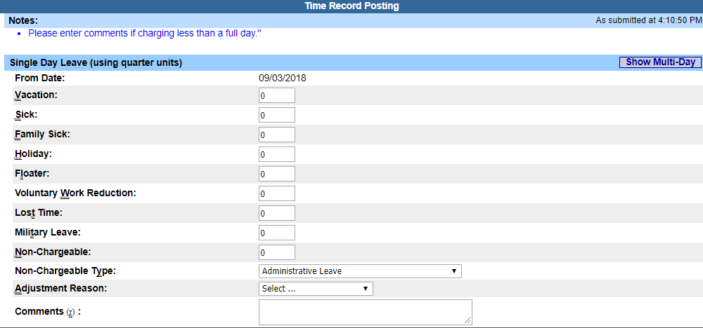
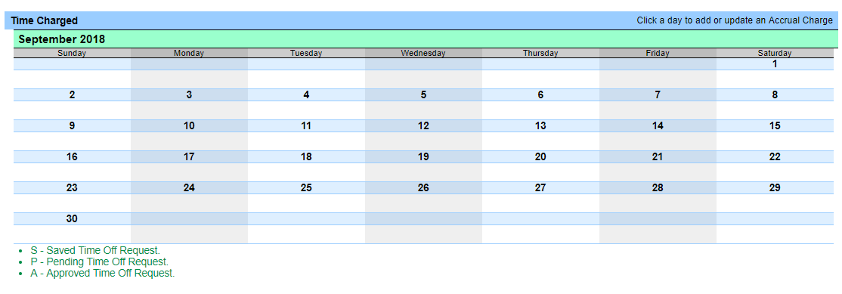
Sick Leave Charged (Cont.)
Enter any sick time used by double-left clicking on the day as it shows on the calendar. This action produces a pop-up box, where you may charge any quarter day entry up to “1” in the box beside the Sick Leave section. (Sequential days charged for the same reason code can be entered via the multi-day entry selection.)
Click on “Save”

Slide 8
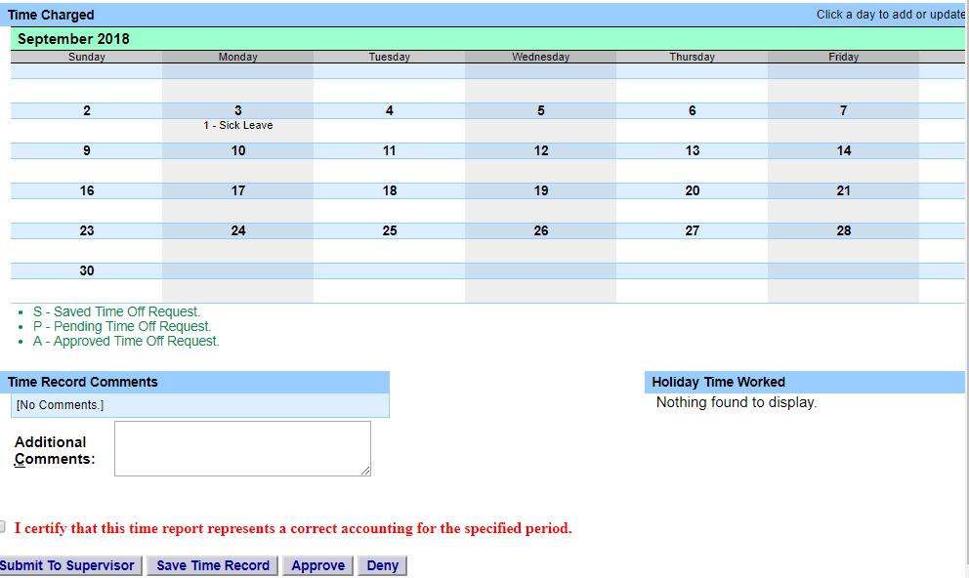
Sick Leave Charged (Cont.)
Certify and submit your monthly record for approval.
Review ALL your sick leave entries for correctness, then, click the “CERTIFY” box.
Next, click “SUBMIT TO SUPERVISOR” ( on the bottom of the screen toward the left).

Slide 9
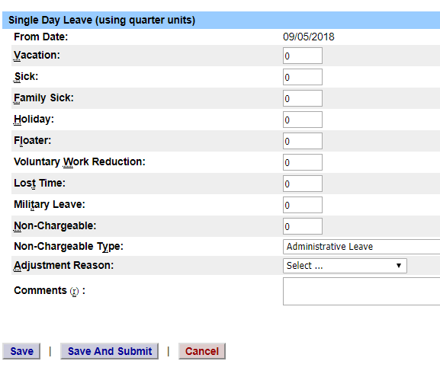
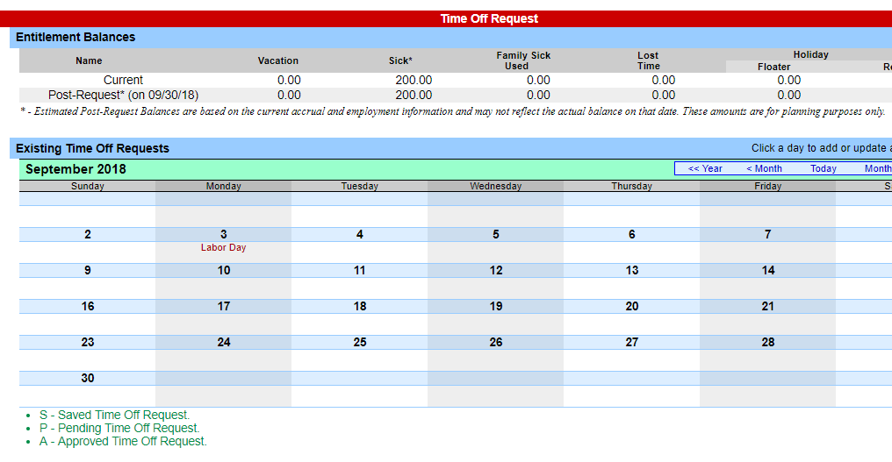
Sick Leave Pre-requested
Select Request Time Off from the menu bar located at the top of the screen (shown above).
To request time off from your supervisor, double click on the day you wish to request off.
This action produces a pop-up box, where you may charge any quarter day entry up to “1” in the box beside the Sick Leave section. (Sequential days charged for the same reason code can be entered via the multi-day entry selection.)
Click on “Save”

Slide 10
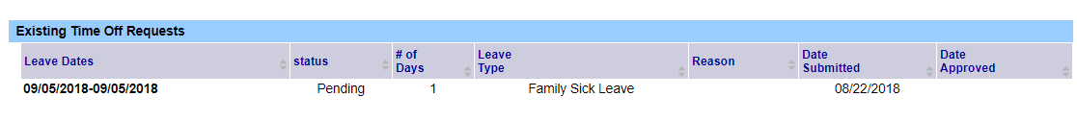

To Request Sick Leave (Cont.)
The day(s) requested will now appear on your time off request calendar and will be listed below under Previously Submitted Leave Requests.
To submit your request to your supervisor, click on the radio button next to the appropriate time off request, then click “SUBMIT ACTIONS”

Slide 11
Non-Chargeable Time Records
Select Request Time Off from the menu bar located at the top of the screen (shown above).
To request time off from your supervisor, double click on the day you wish to request off.
This action produces a pop-up box, where you may charge any quarter day entry up to “1” in the box by:
  Entering the amount of time in quarter day increments in the “Non-Chargeable” box
  Select the appropriate non-chargeable leave type from the drop down menu in the “Non-Chargeable Type” box
  Sequential days charged for the same reason code can be entered via the multi-day entry selection.
Click on SAVE
The day(s) requested will now appear on your time off request calendar and will be listed below under Previously Submitted Leave Requests.
To submit your request to your supervisor, click on the radio button next to the appropriate time off request, then click “SUBMIT TO SUPERVISOR”

Slide 12
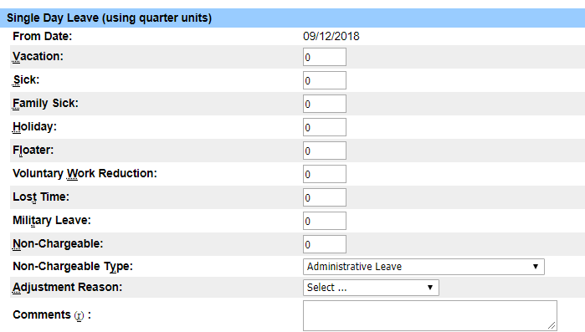
Non-Chargeable Types

Slide 13
Sign-Off
To sign-off and sign-out of the SUNY browser, click the “SIGN-OFF” at the top right of the page.
Then, you can close the browser by clicking the “X” at the top right of the screen.

Slide 14
Contact Information for Questions & Assistance:
Kimberly Truax, ext. 5616
  Email: Payroll@geneseo.edu

