Slide 1


Slide 2
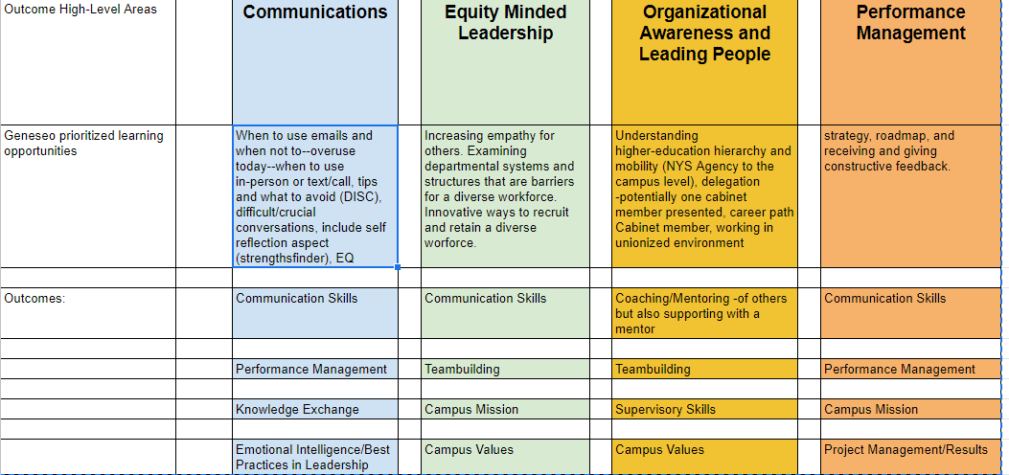
Geneseo Leadership Journey: Lean into your future Model and Framework

Slide 3
Geneseo Leadership Journey Program Elements
On-going Leadership Development Training & Activities
Competency Driven Training Modules
Small Group Coaching Sessions
Team-based Projects & Presentations
360 Degree Feedback for Development Plans
Cross Cohort Mentoring

Slide 4

Geneseo Leadership Journey: Lean into your future Model and Framework
Phase 1: classroom programs, coaching sessions, team project/presentation, and time with mentors
Phase 2: classroom programs, increased coaching sessions, day in the life activity, time with mentees
Phase 3: 360 degree assessment, learning plans, time with mentees/mentors, classroom programs
This is a journey, not a destination!

