Slide 1

Student Health Insurance & Trip Cancellation/Interruption Coverage
For Study Abroad Programs

Slide 2
How Does This Plan Work?
Medical expenses are very costly and without active, in-network medical insurance while abroad, students can owe exorbitant amounts for healthcare.
The SUNY International Health Insurance Plan will help pay for medical bills that you will incur when you go to the doctor, hospital, or pick up prescription medication abroad.
In addition to health insurance the plan provides assistance for managing medical and travel emergencies while on your study abroad program.
Trip cancellation and interruption coverage is available separately on a voluntary basis.

Slide 3
How Do I Enroll?
These insurance policies are mandatory and are included in the SUNY tuition fees for each student’s protection during their study abroad program. Your study abroad office will enroll you.
Coverage is available voluntarily for your spouse and for your child(ren)

Slide 4
What Does This Plan Cover?
Preventative Care
Primary Care Office Visits
Urgent Care Visits
Emergency Care
Inpatient/Outpatient Hospital Care
Mental Health Services
Required Immunizations
Prescription Drugs
Labs and Imaging
Ambulance
Maternity and Nursery Care for a Covered Pregnancy
Medical, Political, Natural Disaster Evacuation & Repatriation
Trip Cancellation/Interruption (if purchased separately)

Slide 5
Summary of Plan Benefits
Plan Design (Per Person, Annually) | In-Network Benefits
Annual Deductible | $0
Coinsurance | 0%
Preventative Care Services | Covered in full (annual physical, OB-GYN)
Primary Care Visit | 0% Coinsurance/Copay
Urgent Care Visit | 0% Coinsurance/Copay
Emergency Room | 0% Coinsurance/Copay
Ambulance | 0% Coinsurance/Copay
In-Patient Hospital Care | 0% Coinsurance/Copay
Prescription Drugs | $0 for Tier 1/2/3

Slide 6
How Do I Get Started?
You will receive an email from notifications@uhcsr.com that an ID card is available for you.
To view, download or request a hard copy ID Card, to please visit https://myaccount.uhcsr.com/

Slide 7
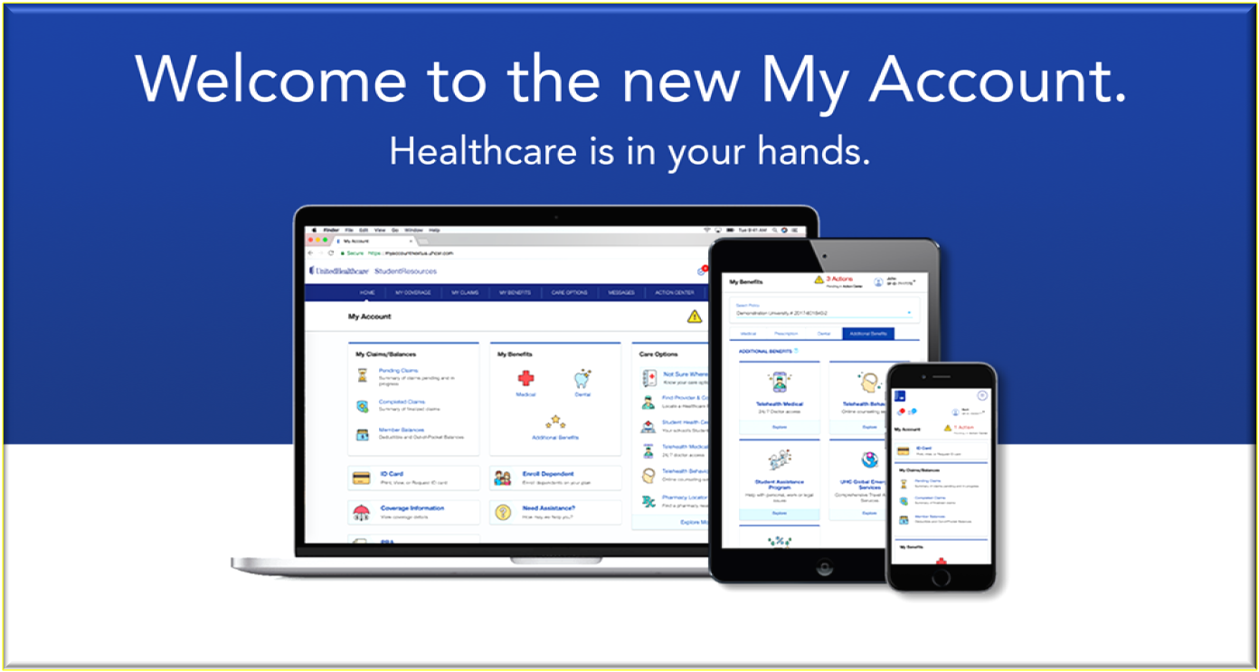
You Can Access Your Account from Your Computer, iPad or SmartPhone 24/7

Slide 8
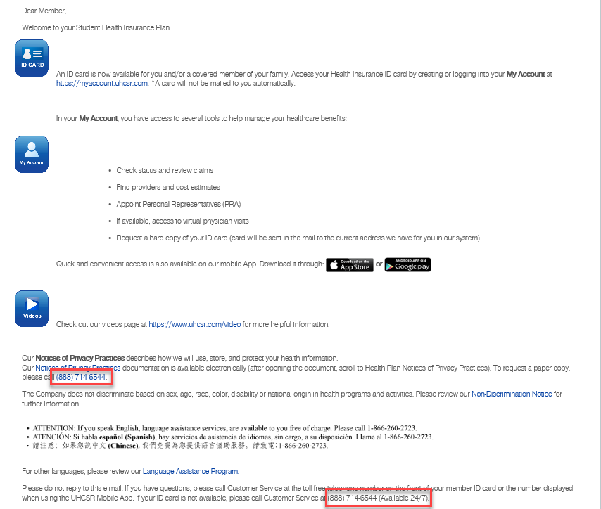
This is what the email looks like ☺

Slide 9
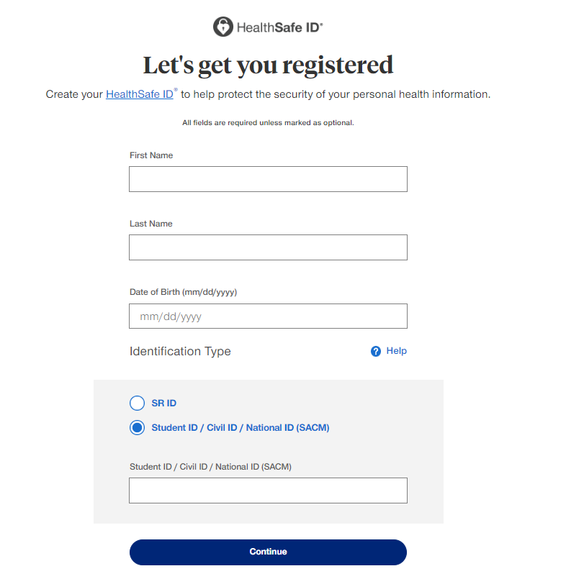
This is what the screen looks like to create your account for the first time so that you can grab your Health Insurance ID Card

Slide 10
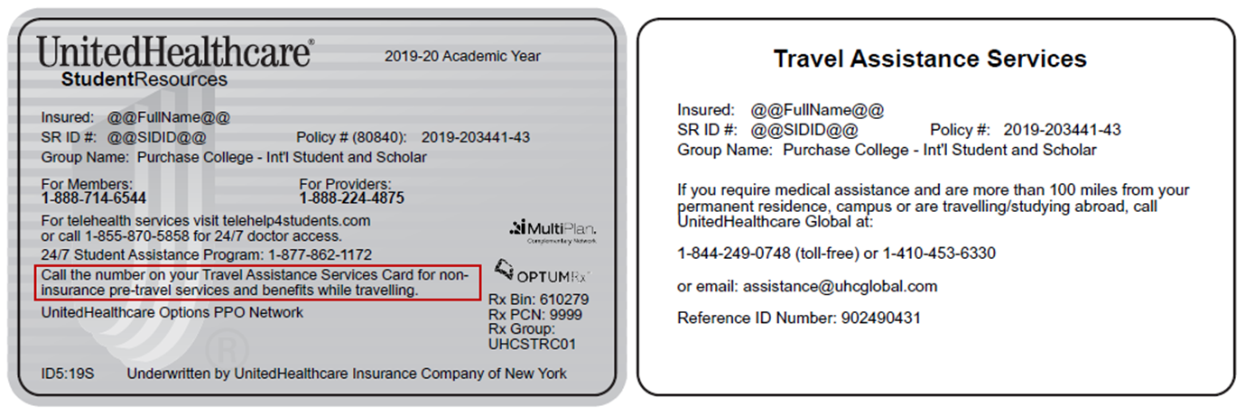
What Will My Health Insurance ID Card Look Like?

Slide 11
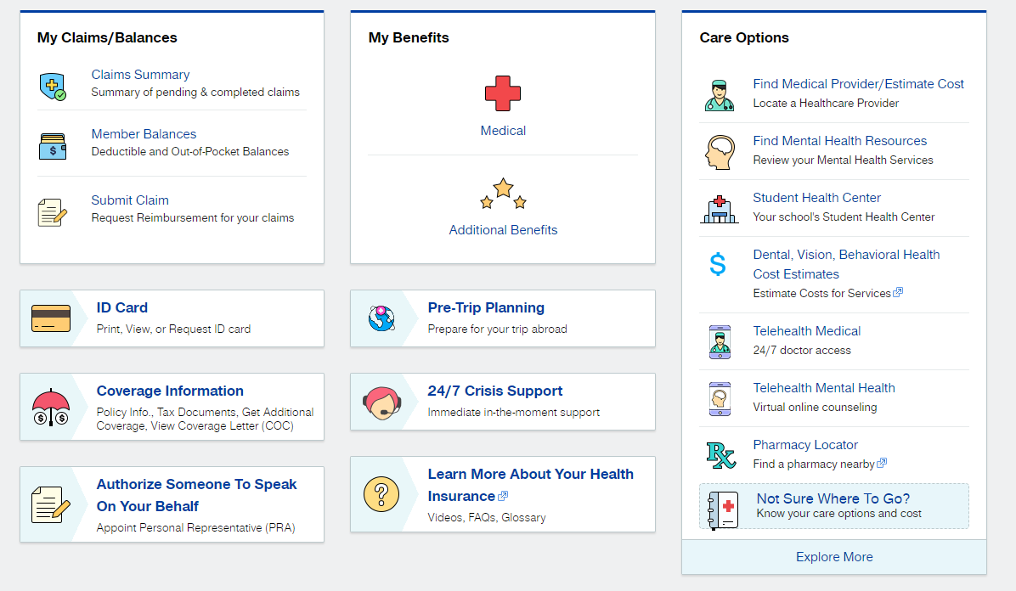
Here’s What You Can Do In UHC MyAccount

Slide 12
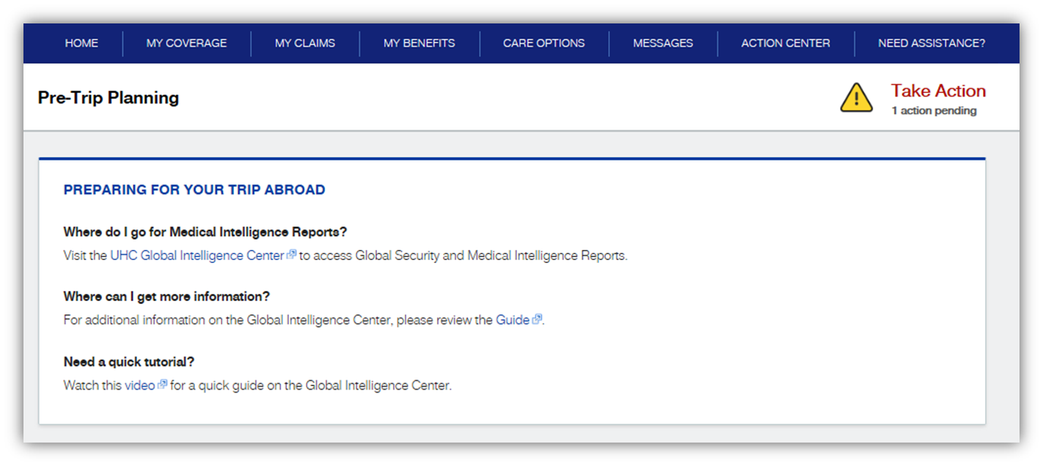
Travel Abroad Enhancements

Slide 13

Telehealth Services- Mental & Physical
Process: member visits the HealthiestYou app or website here and completes a questionnaire. Member provides their UHCSR insurance information from UHCSR ID card, emergency contacts and their goals for the service. The questionnaire will also ask for counselor preferences (gender, specialty, etc.) to ensure member is matched with a practitioner that can help meet their goals
Within 24 hours after completing the questionnaire, the member will be contacted by a counselor to schedule an appointment and decide on a communication method that best suits their needs

Slide 14

Landing Page
For Physical & Mental TeleDoc Services
Notes:
14

Slide 15
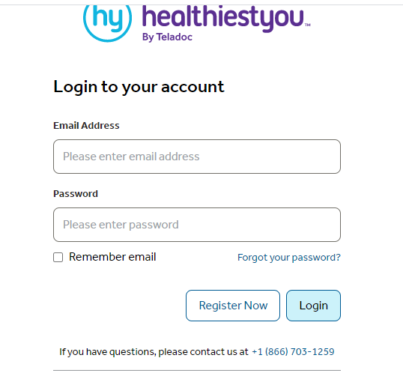

Slide 16
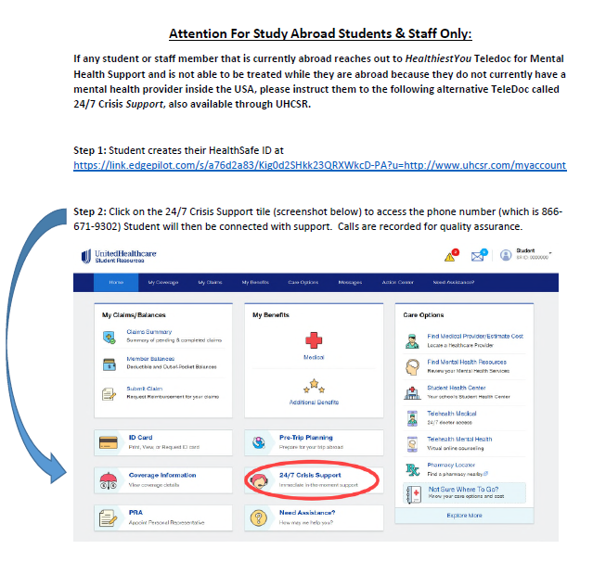

Slide 17
How Do I Locate Providers Abroad and Pay For Services?
Step 1: Call 844-249-0748 (number on back of ID card or +1 – 410-453-6330) or email assistance@uhcglobal.com .
Step 2: UHC will advise of nearest provider that meets their standard of care.
Step 3: UHC will call provider and pre-pay them for your visit.
Step 4: Show your insurance ID card to any Doctor’s offices that you visit, as well as pharmacies, labs, etc.

Slide 18
How To File A Claim Abroad:
Travel Abroad Claims Submissions:
If payment is not arranged at the time of service via UHC Global, the student may email all claim information to UHCSR at si.drg@uhcsr.com (a claim form is not needed to submit a claim, but UHCSR needs the student’s SRID number from their insurance card)
Please remember when submitting a claim:
Member must include proof of payment for reimbursement.
If payment was made by check, a copy of the front and back of the cancelled check needs to be included.
For all credit card payments, the credit card statement showing the cardholder’s full name, institution name and payment information for each date of service is required.
If payment was made with an ATM or Debit card, the bank statement showing the accountholder’s full name, institution name and payment information for each date of service is required. UHCSR will call the provider of services to verify all cash payments.

Slide 19


Need Support?
For Health Insurance Plan or Claim Assistance
888-714-6544 or email customerservice@uhcsr.com
To Locate Providers Abroad, Monitor Travel Risks, View Medical Intelligence Reports, Daily Security Briefings of Global Events, View Drug and Language Translation Guides:
844-249-0748 or email assistance@uhcglobal.com
For Broker Assistance
866-535-0456 or student@haylor.com

Slide 20
Thank You, On Behalf Of
The HFC Collegiate Team

