Slide 1
Analyt II Notes
Homework-Ch15
Due on Monday
We will have Quiz 1 on Monday at 8:30am sharp!
Make sure your lockdown browser works
use “lockdown browser test” on WebAssign
No make-up quiz
Covers Ch. 15’s content

Slide 2
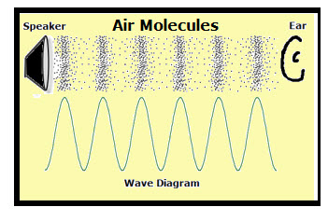
Chapter 16: Waves - I
Waves are a primary subject in Physics
Music and sounds
Light
Ripples on water
Types of waves :
Mechanical waves
Involves disturbance of material
Water waves
Sound waves
Seismic waves
Need a medium to propagate

Slide 3
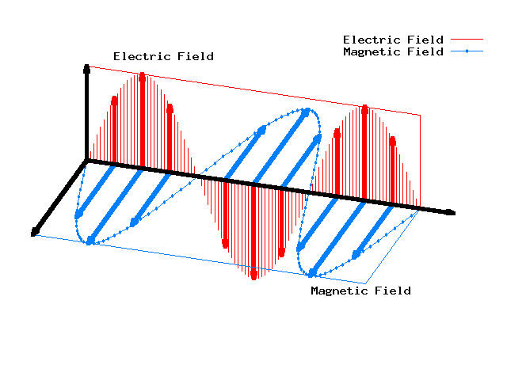
Chapter 16: Waves - I
Types of waves:
Electromagnetic (EM) waves
Light (UV, radio, visible, x-rays, etc)
Made of electric+magnetic components
All EM waves travel at same speed (c ≅ 3×10⁸ m/s)
No medium needed to propagate

Slide 4
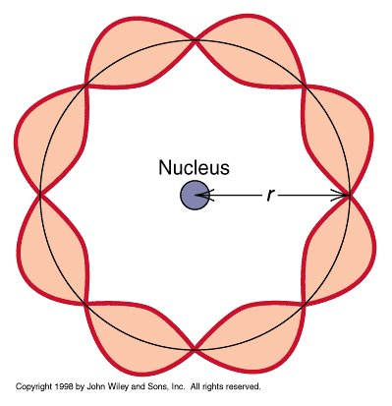
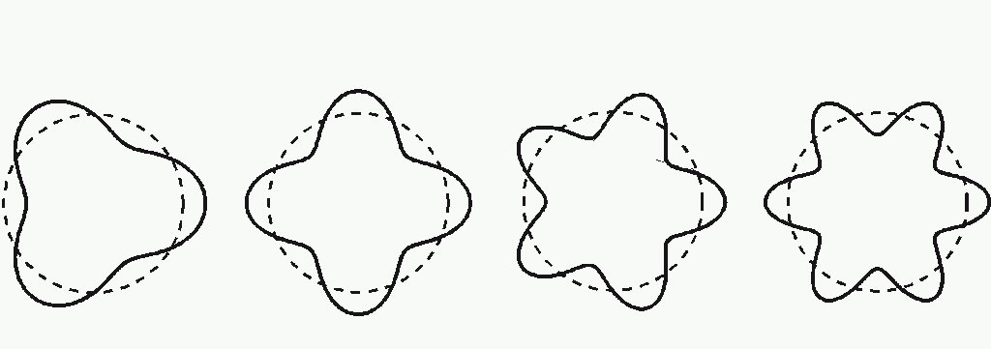
Chapter 16: Waves - I
Types of waves:
Matter waves
Associated with fundamental particles (protons, electrons)
Reflects wave-particle duality
It’s a concept of quantum mechanics
Also called “de Broglie waves”

Slide 5
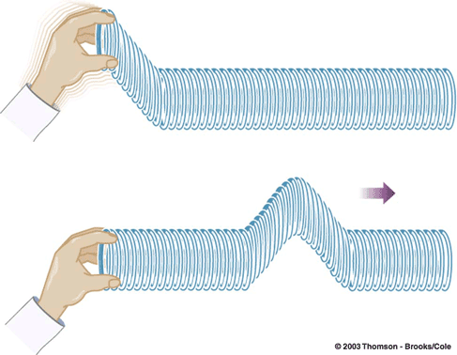
§16-1: Transverse Waves
A transverse wave is
disturbance for which the displacement is perpendicular to the propagation direction
The displacement forces the next section to move
Generates chain reaction of motion when the displacement changes with time (wave velocity)
Video examples:
2 pulses (animation)
1 pulse (real life)
displacement
propagation

Slide 6
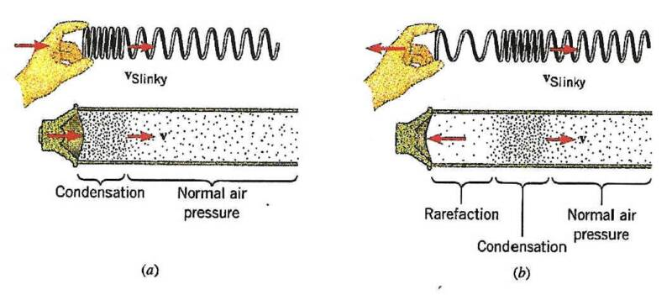
§16-1: Longitudinal Waves
A longitudinal wave is
disturbance for which the displacement is parallel to the propagation direction
The displacement forces the material to compress and decompress

Slide 7
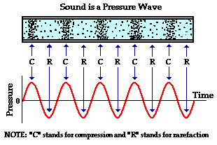
Sound Wave is Longitudinal
Harmonic wave (red)
Plotting pressure of air vs time, we can see the wave
(that why it is also described as a compression wave)

Slide 8
Transversal VS Longitudinal
Difference is the direction of displacement with respect to the direction of propagation of wave
Both are “travelling” waves, since they move from A to B
Combination of multiple waves can lead to “standing” waves

Slide 9
Wave Function
How to fully quantify a wave?
Need a function with a wave shape
y = f(x,t)
Where
y is the resulting displacement
x is along the propagation direction
t is time
f(x,t) is a function that changes in time and space.
Generally, the function has a sinusoidal shape:
y(x,t) = y_{max} sin (kx – ωt)

Slide 10
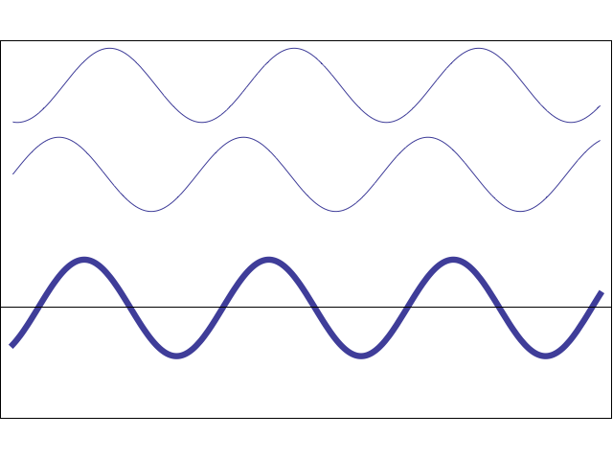
y
y_{m}
x

Slide 11
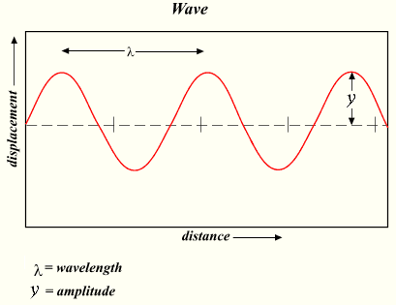
§16-1: Wavelength and Wave Number
Phase:
It’s the argument of sine function, kx – ωt
Most of the wave information is in the phase
Wavelength λ and Angular Wave Number k:
λ is the distance between repetitions of the shape of the wave (parallel to propagation direction)
m

Slide 12
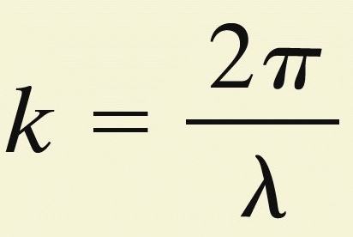
§16-1: Wavelength and Wave Number
λ and k are linked together.
At a given time, say t=0, the wave function is
At both ends of the wave, the value of y(x,0) is the same, so
Because a sine function repeats itself every 2π rad, that implies kλ = 2π (based on eq above). So…
angular wave number
(Not the spring constant!!!)

Slide 13
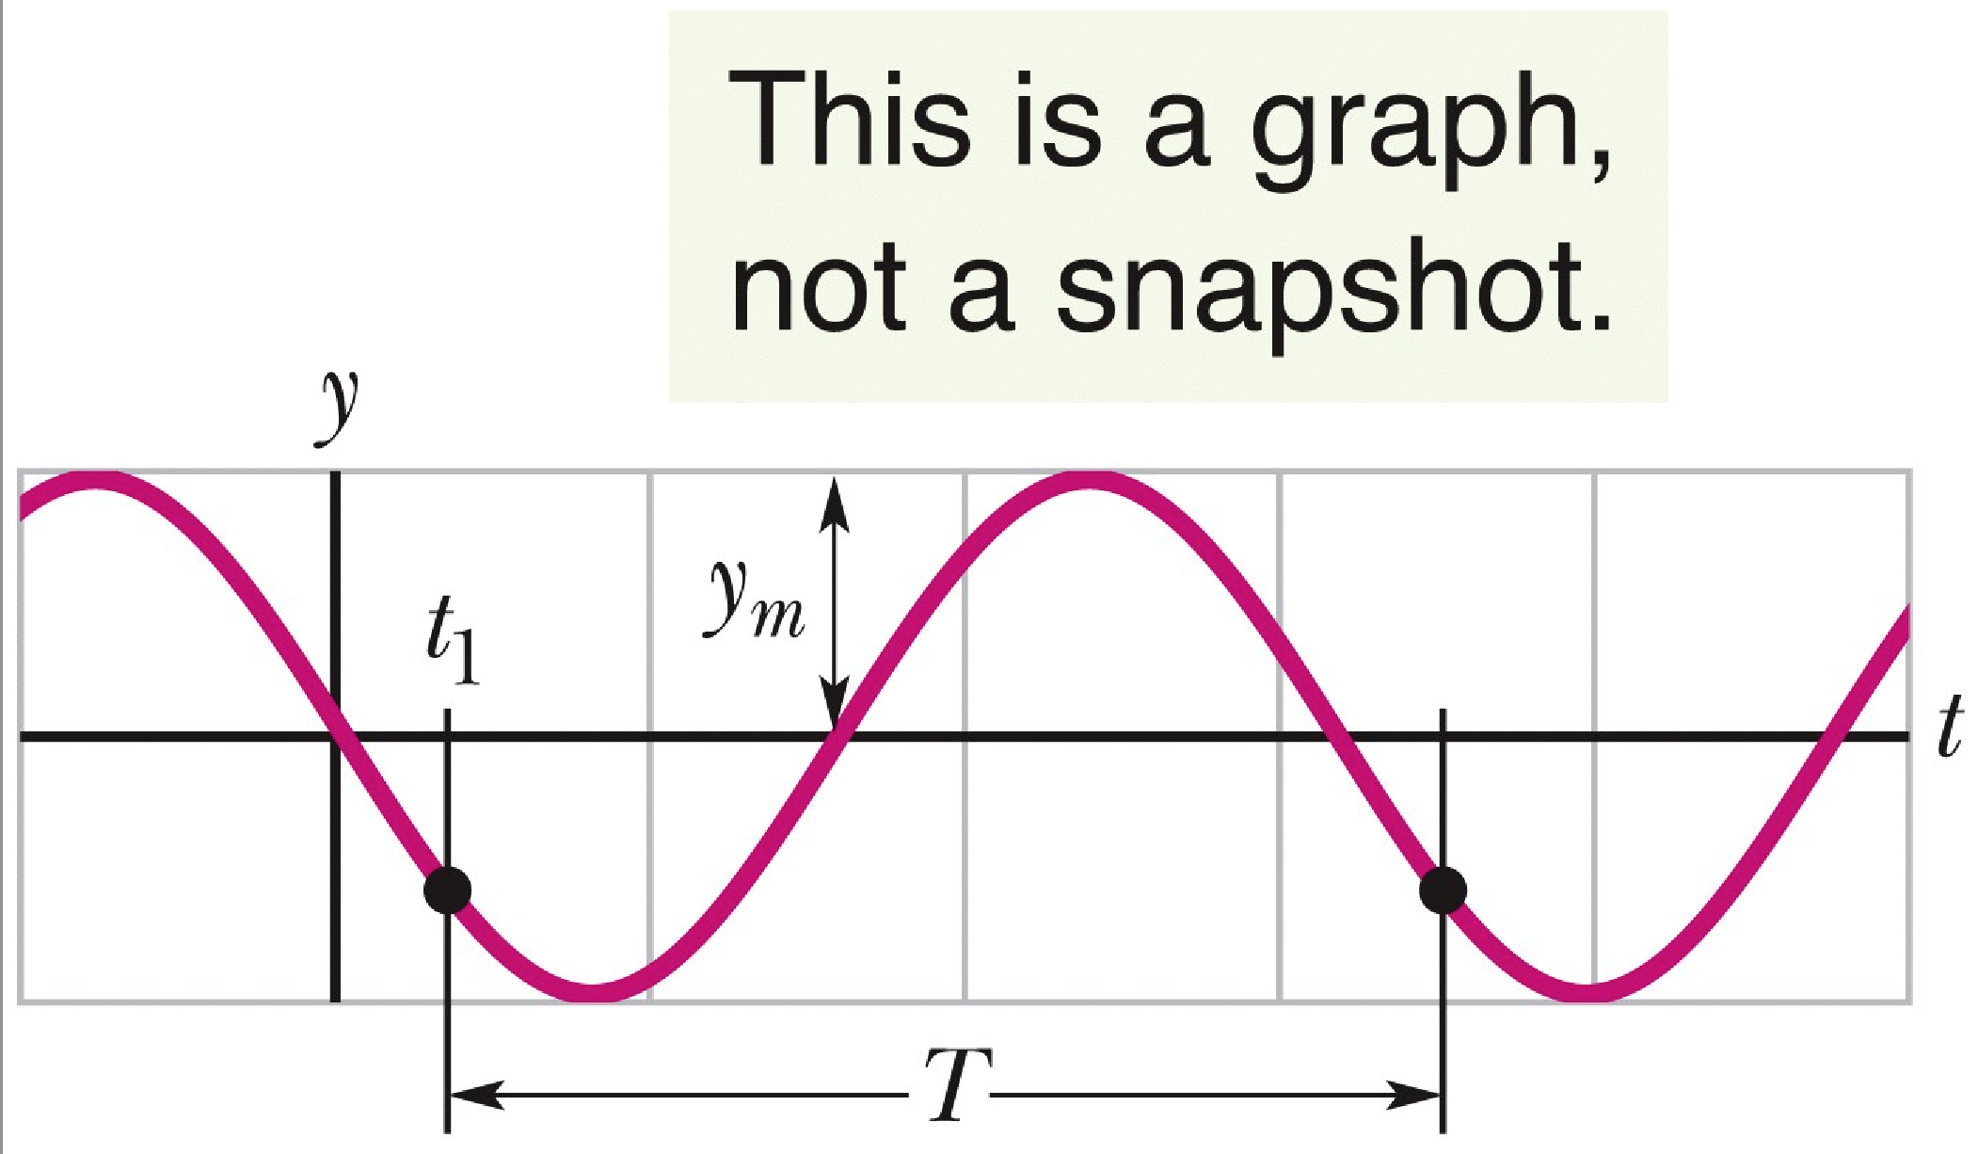
§16-1: Angular Frequency and Period
Frequency ω and period T are also linked.
At a given position, say x=0, the string element is moving up and down with time:

Slide 14
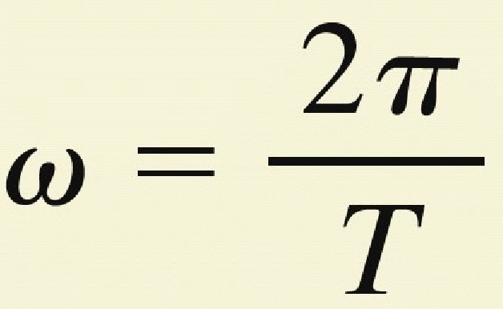
§16-1: Angular Frequency and Period
The time it takes for the wave to move thru a full oscillation, i.e. its period T, is the “time” between two identical y values.
Like we did for λ and k we find that
Therefore, since ωT = 2π rad, then
angular frequency

Slide 15
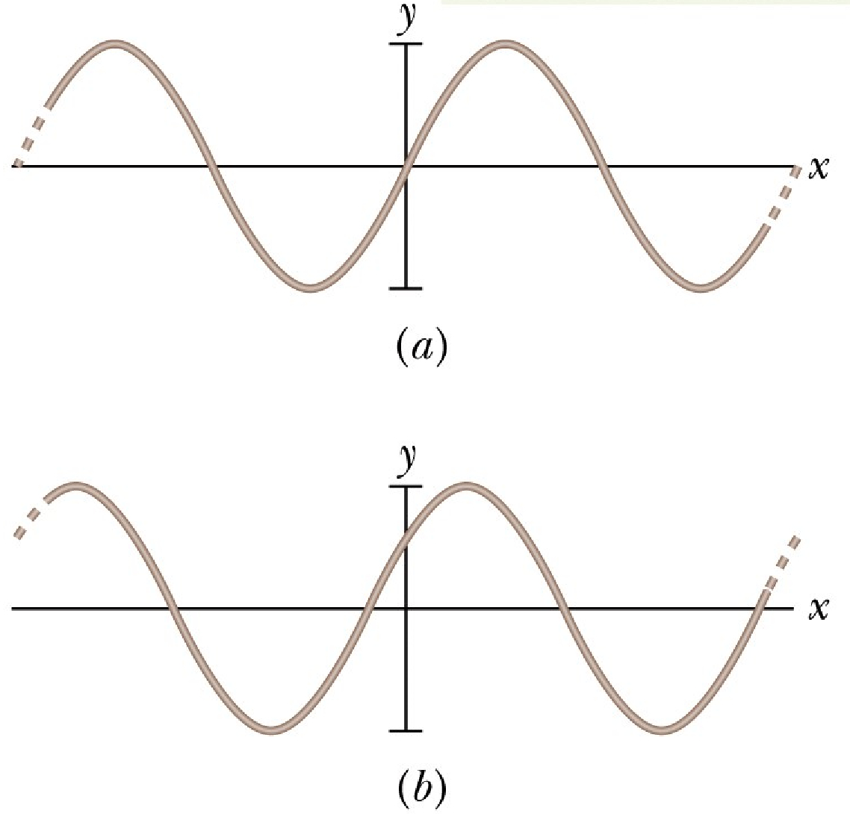
§16-1: Phase constant φ
What if a wave doesn’t start at y(0,0) = 0?
Means there is a shift, called phase constant ϕ
The wave function becomes:
The wave function has
same y_{m} value
same ω value
same k value
different φ value
φ= 0 rad
φ= π/5 rad

Slide 16
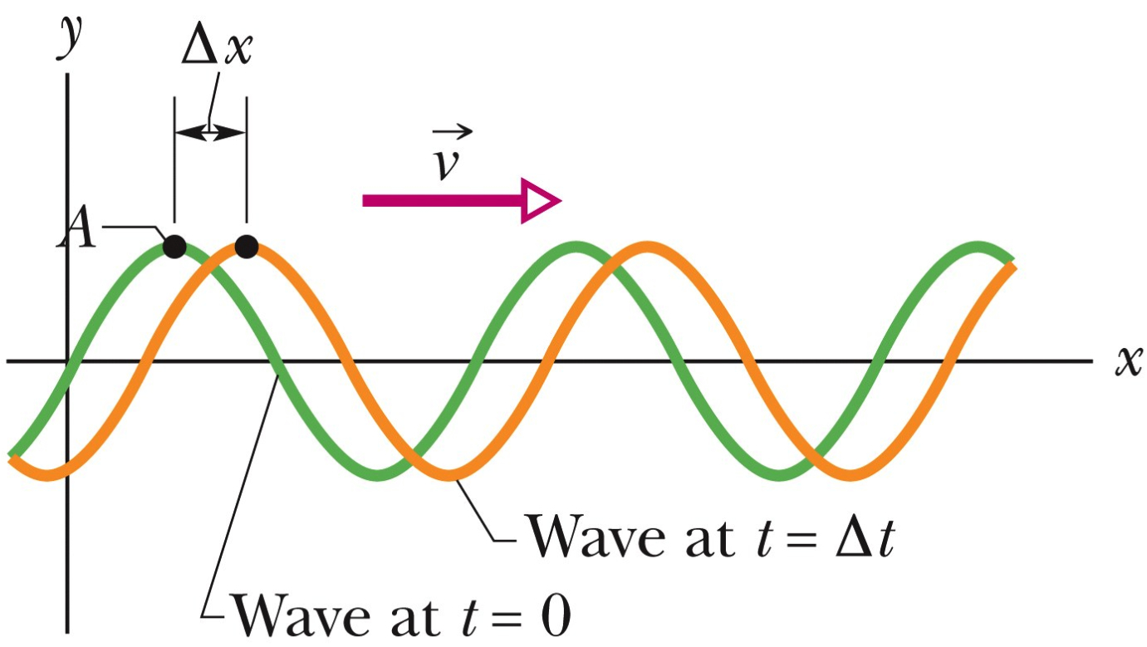
§16-1: Speed of Traveling Wave
Two snapshots of a wave are taken a small time interval Δt apart:
Travelling in +x direction
Wave speed is Δx/Δt (or also dx/dt)
Assuming the wave retains its displacement (i.e. Δx doesn’t change with for fixed Δt value), that means
(in other words, only a φ value is needed to shift wave)
We can now derive this expression to obtain dx/dt…

Slide 17
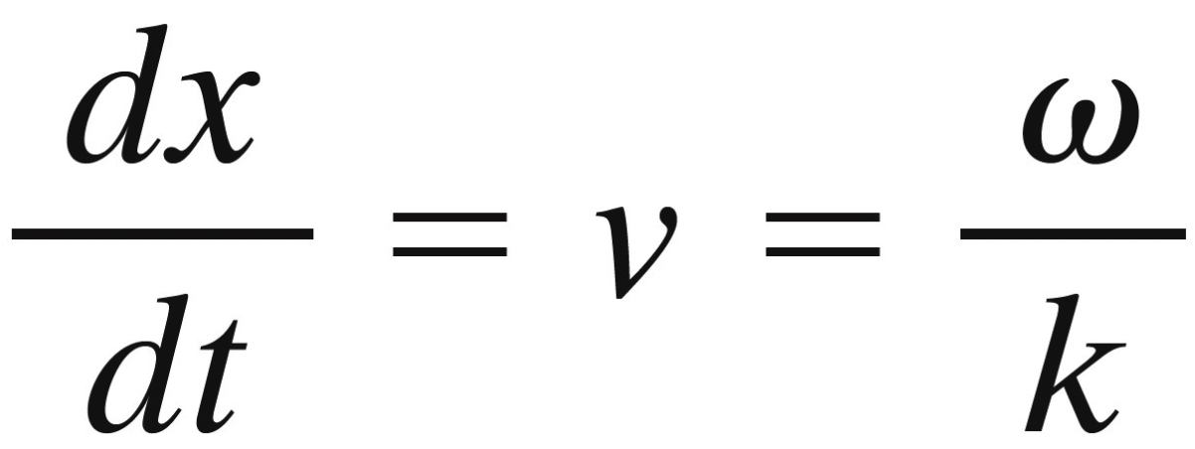
§16-1: Speed of Traveling Wave
Deriving with respect to time:
Rearranging the terms:
Knowing that k = 2π/λ and ω=2π/T, we obtain the expression for the wave speed:
Fundamental
relation!!!

