Slide 1
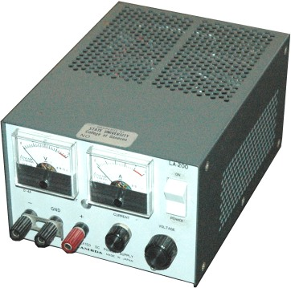
“Power Supply”
Controls Voltage
Difference in Voltage is set
(red minus black)
Output Current is “as requested” by attached device.

Slide 2
“Ground”
“Ground usually means the lower voltage
terminal of any power supply (usually black).
The symbol is either or

Slide 3
“Power Supply”
Can also specify a maximum
allowed current
Generally, this does not
change the voltage.
The current can still be less
than this limit.
Current limit

Slide 4
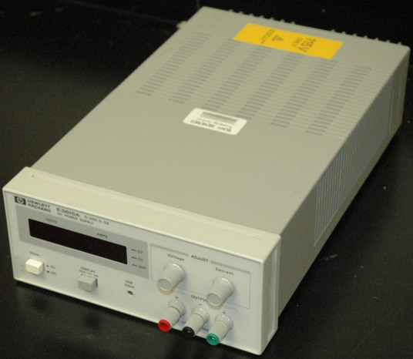
“Power Supply”
But, if current reaches the max, then the voltage is lowered until the current is small enough…
Current limit

Slide 5
Wires: The voltage at all points along
its length are equal
Two VERY bad (but distressingly
common) circuits:

Slide 6
Acceptable Circuits
stuff
stuff
stuff
stuff
stuff
stuff

Slide 7
Sort of Acceptable Circuit:
Used to increase current to “stuff”.
Both power supplies must be set to exactly the same voltage!
stuff

Slide 8
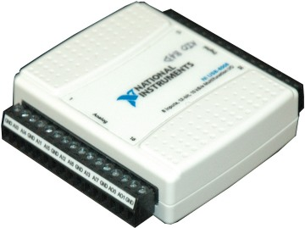
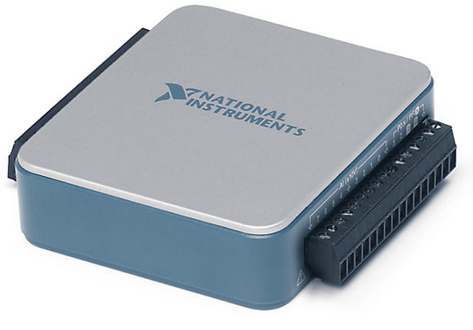
Analog DAQ
Do NOT attach the output
of any other device to any
AO wire!

Slide 9
Analog DAQ
Of course you can (and
should) attach the output of
other devices to an AI wire.
Connect the ground of the other device to one of the grounds on the analog side of the DAQ.

Slide 10
Analog DAQ
Warning! Analog inputs
to an AI wire on the
USB-600x may only have
a voltage that is
-10v < V < +10v!
Use “RSE”:
(Reference – single ended), meaning all voltages are relative to “ground”

Slide 11
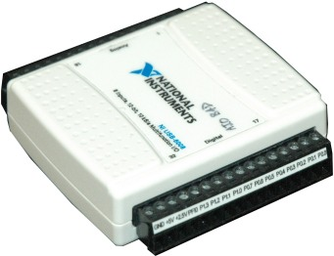
Digital DAQ
Do NOT attach the output
of any other device to any
DIO wire unless you are 1000% sure that:
a. The device is making a voltage 0v < V < 5v.
b. The DAQ DIO line is configured as an input.

Slide 12
Digital DAQ
This is easy to screw up if you are still working on the LabVIEW code to configure the DIO lines as inputs or outputs!
Be sure to connect a digital ground on the DAQ to the ground of the other device.

Slide 13
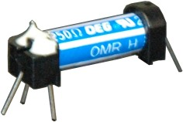
DC Relay
Used to allow a low-current
device (such as a digital
output on the DAQ) to control a higher current
device (like anything else).
The version shown here is for “small”
devices that run on DC current.

Slide 14
Relay
To device requiring higher voltage and/or current
From DAQ DIO
From higher voltage and/or
Higher permitted current power supply
To DAQ DIO;
|ΔV_{digital}| > 3 V
to operate

Slide 15
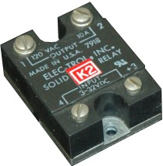
AC Relay
To device requiring AC power
From AC (wall) power
To DAQ DIO
From DAQ DIO

Slide 16
In practice, relays should only be used in a way that you probably think is backwards:
You’ll use 0V to turn it on, and +5V to turn it off!
+5V power supply
(provided on DAQ)
RELAY
device
Digital Control: use 0 volts to activate the device!

Slide 17
AC Relay
DAQ
DIO
+5 V

Slide 18
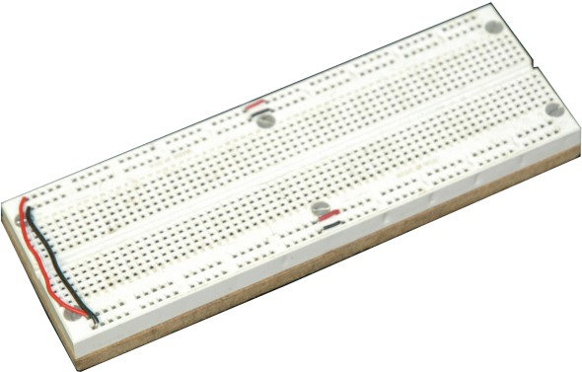
Prototyping board

Slide 19
Prototyping board

Slide 20
Prototyping board

Slide 21
Prototyping board

Slide 22
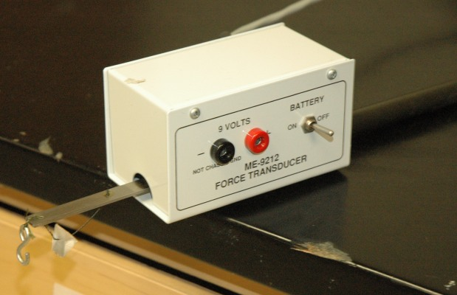
A Force Sensor

Slide 23
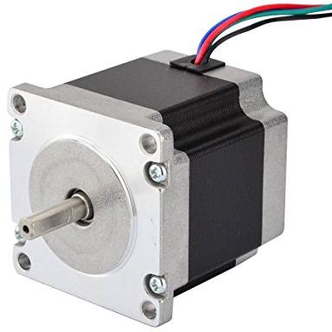
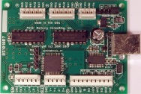
A “stepping motor” and its controller.

Slide 24
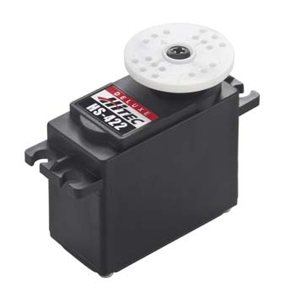
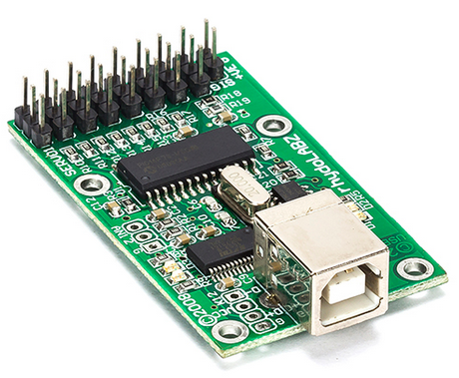
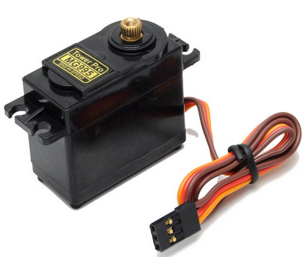
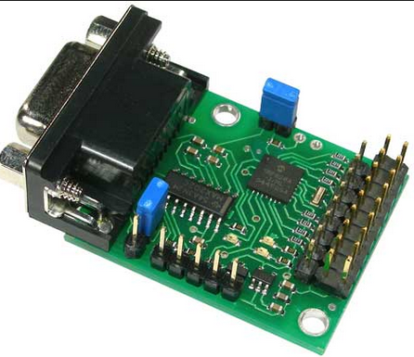
Some “servo motors” and a controller.
USB
Serial

Slide 25
Assignment #7 uses servos.
Servos use a LOT of energy to turn to a new position. They also use a lot of energy to just “stay in one place”.
The servo controller will burn up if you leave it on for a long time (5 or 10 minutes), even if you aren’t moving the motors. So turn them OFF while debugging!

Slide 26
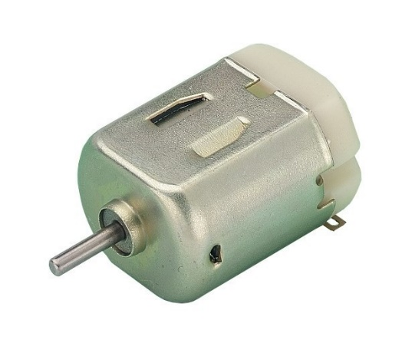
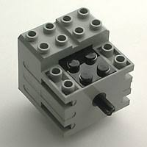
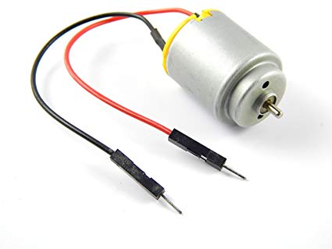
Some “DC motors”

Slide 27
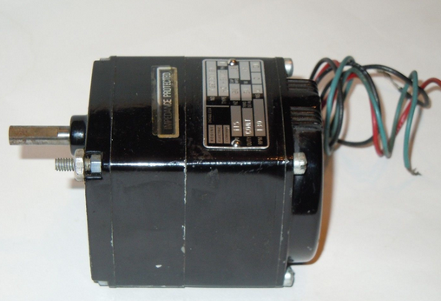
An “AC motor” (very strong!)
You do not have permission to shorten any wires on anything you use from this room!

Slide 28

You may not disassemble anything that I own. Period.
If you “need” to trash a motor, controller, etc., buy your own first.

